Slide 1
Queensland Referees
Referee Management Structure

Slide 2
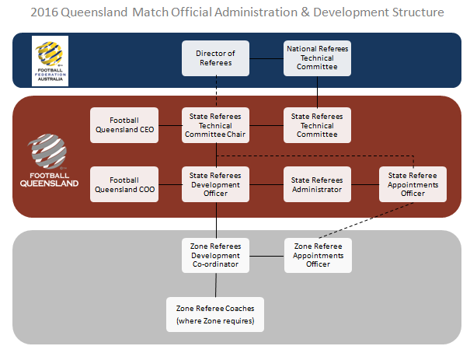
Management Overview
Following a review of Match Officials registrations and accreditations across the state it has been realised that referee numbers are on a steady or downward trend in many Zones. FFA surveys of Match Officials has reported that the number one reason for them leaving the game, regardless of whether an identified elite referee or a weekend warrior, is a lack of mentoring and development opportunities. Critical to the delivery of this development support is the availability of enough assessors and instructors at the correct levels within each zone to support the needs of that zones referee numbers. A review of these critical metrics in Queensland has shown us to be clearly deficient in this area and our current planning does not have provision to rectify the situation
With a view to maximise the opportunity for referee education & development FQ will be implementing a uniform management structure across all Zones in 2016. This new structure will give referees a far greater level of education & development providing each referee with the opportunity to progress within the well structured, uniform & modern refereeing education system.
FQ is committed to providing the Queensland Football Family with the best referees in Australia, this important step will help us achieve this target.

Slide 3
State Referees Technical Committee
The State Referees Technical Committee is responsible for the performance of ALL of Queensland’s Match Officials and for the implementation of the referees national curriculum as directed by FFA. It supervises the career development of all registered Match Officials by ensuring that FFA’s requirements and processes are implemented.
Chair is a voluntary position appointed by the FQ CEO
Role of Chair supersedes the position of State Coach
Consists of 5 to 7 volunteer members from refereeing and non-refereeing community, appointed by the Chair and approved by the FQ CEO
Chair reports to the National Referee Technical Committee
Must demonstrably comply with all FFA directions regarding the development, training, education, coaching and qualification of Match Officials
Identifies registered Match Officials ready to undertake further programs and recognition at National Level
Monitors, supervises and assesses registered Match Officials undertaking Community Level programs and qualification processes

Slide 4
State Referee Development Officer
The State Referee Development Officer is a paid position responsible for the overall growth and development of refereeing, with particular emphasis on improving the structures and enhancing communication, together with raising the standard of referee education and coaching across the state.
Overview:
Developing and implementing a Match Official Development and Operational plan in accordance with the FFA and Football Queensland Refereeing Strategic Plans;
Establishing a relevant Match Official coaching structure within the state;
Developing, coordinating and managing training and fitness testing regimes for Football Queensland elite Match Official s including the maintenance of attendance and other records;
Managing the State Referees Administrator to ensure the coordination of FFA Referee Courses and Match Official Accreditations using the National Accreditation Management System;
Overseeing the consolidation and adaptation of the Football Queensland Elite Referee Panels;
Promoting Match Official education and training programs and coordinating recruitment and retention initiatives;
Coordinating and delivering FFA and FQ Referee Recognition and Development Programs;
Coordinating Football Queensland Match Official Seminars;
Providing Match Official sand clubs with support, including liaison and education on matters pertaining to the Laws of the Game;
Coordinating the refereeing pathway within the state including the State and Zone Talent Pools;
Providing leadership, direction and advice for all Zone Refereeing Development Coordinators, in particular in the area of coaching and assessment
Accreditations:
Current FFA Level 3 Instructor and Assessor or equivalent
Current FFA Level 3 Futsal Referee or equivalent
Current Referee Level 2 (Theory) or equivalent

Slide 5
State Referee Appointments Officer
Working closely with the State Referee’s Development Officer and the State Referees Technical Committee Chair, The State Referees Appointments Officer is a paid position that appoints referees on Elite and Talent Identified Panels to designated state and zone competitions and other sanctioned matches.
Overview:
Managing the appointment of registered referees to all designated elite competition matches, designated school tournaments and other sanctioned matches via the National Referee Appointments System
Managing the appointment of Referee Inspectors designated elite competition matches in accordance with the State Referees Technical Committee Chair or State Referee Development Officer requirements
Implementing any special requirements of the State Referees Technical Committee Chair or State Referee Development Officer when making appointments.
Reporting any repeated unjustified withdrawals or rejections of appointments by referees to the State Referees Technical Committee Chair and State Referees Development Officer.
Ensure the efficient management of financial systems associated with payments to match officials and invoicing of clubs for referee charges;
Liaising closely with the State Referees Technical Committee Chair and State Referees Development Officer to effectively manage the coordination of Queensland’s elite referees.
Liaising with referees, competition managers and other clients by email, telephone or face-to-face.

Slide 6
State Referee Administrator
Working closely with the State Referee’s Development Officer and the State Referees Technical Committee Chair, The State Referees Administrator is a paid position that ensures that the administration of all Referee Education and Technical Department is completed effectively..
Overview:
Maintain the National Accreditation Management System by maintaining personal information on established database and registering Referee courses as scheduled
Processing completed courses and despatch accreditation certificates
Reporting on current and target levels of accreditation to State Referees Development Officer and Zone Referees Development Coordinators
Liaising with FFA Referee Education Coordinator, State Referees Development Officer and Zone staff to schedule referee and coach courses
Despatching resources and participant lists for scheduled referee courses and clinics
Ensuring the registration of all referees, referee instructors and referee assessors on the National Registration System
Being responsible for the effective management of record keeping systems, database and distribution lists (electronic and manual) relevant to referee administration, discipline, development, assessment and training.

Slide 7
Zone Referee Development Coordinator
In conjunction with the State Referee Development Officer, the Zone Referee Development Coordinator is a volunteer or paid position responsible for the overall growth and development of refereeing within their Zone, with particular emphasis on improving the structures and enhancing communication, together with raising the standard of referee education and coaching.
Overview:
Managing the Zone Referee Appointments Officer and or Zone Referees Coaches (where applicable) to ensure the coordination of all Match Official matters within Zone.
In conjunction with the State Referees Administrator, manage the delivery of all FFA accreditation courses and ensure the coordination of Match Official Accreditations using the National Accreditation Management System
In conjunction with the State Referees Development Officer, mentor FFA Accredited Course Instructors, promote Match Official education and training programs and coordination of recruitment and retention initiatives, coordinate Match Official Seminars and Match Official Development Programs
Provide advice and material on Match Official matters to the Zone Executive
Provide regular reports to the State Referees Development Officer
In conjunction with the State Referees Development Officer, distribute regular communication to Match Officials, provide support to Zone Match Officials, including matters relating to the Laws of the Game
In conjunction with the State Referees Development Officer, coordinate the Match Officials Development Pathway within the Zone, provide coaching, assessment and advice for Zone Coaches where they exist.
Accreditations:
Current FFA Level 3 Instructor and Assessor or equivalent or be prepared to undertake training to gain
Current FFA Level 3 Futsal Referee or equivalent or be prepared to undertake training to gain
Current Referee Level 2 (Theory) or equivalent or be prepared to undertake training to gain

Slide 8
Zone Referee Appointments Officer
Working closely with the Zone Referee Development Coordinator and the State Referees Appointments Officer, the Zone Referee Appointments Officer is a volunteer or paid position that appoints referees to the Zones designated non-elite competitions and other sanctioned matches.
Overview:
Managing the appointment of registered referees to all designated non-elite competition matches, designated school tournaments and other sanctioned matches via the National Referee Appointments System
Managing the appointment of Referee Inspectors designated non-elite competition matches in accordance with the State Referees Technical Committee Chair or State Referee Development Officer requirements
Implementing any special requirements of the Zone Referee’s Development Officer and the State Referees Appointments Officer when making appointments.
Reporting any repeated unjustified withdrawals or rejections of appointments by referees to the Zone Referees Development Coordinator.
Ensure the efficient management of financial systems associated with payments to match officials and invoicing of clubs for referee charges;
Liaising with referees, competition managers and other clients by email, telephone or face-to-face.

Slide 9
Questions
Please contact the FQ Referees Department
(07) 3208 2677
admin@footballqueensland.com.au

