Slide 1
ASSESSOR / REFEREE COACH SEMINAR 2020

Slide 2
ACKNOWLEDGEMENT TO COUNTRY
Notes:
"Thank you for being here today, at Mt Maria College who have as their motto, 'Strong Mind - Compassionate Heart'.
I wish to provide an Acknowledgement of Country on the land that we gather on today.
We are now on land surrounded by great Aboriginal names such as Keperra(h), Enoggera(h), nearby Bunya(h), to the south Mt Coot-tha(h), to the north Yugar(r-h) - these names have important Aboriginal meanings and connection to this land.
We Acknowledge the Traditional Owners, and wish to pay respect to the Elders past, present, and emerging. We thank them for treading lightly on their land.
Traditional Owner Elders are responsible for caring for the land and their people. They have strong minds, and importantly, compassionate hearts.
We, as a senior mob of the Qld Football Referees, also need to heed from these attributes. Please think about the important role that you each have, and we have as a collective senior body.
Thank you."

Slide 3
AGENDA

Slide 4
Agenda
Time | Agenda item
9:00 – 9:05 | Housekeeping
9.05 – 9:40 | Welcome o expectations for the season o assessment format / marking o pathway
9.45 – 10:30 | What makes a good Assessor /Referee Coach (tips and tricks)
10.30 – 11.00 | Morning Tea
11:00 – 13:00 (35mins per session) | Technology and the Assessor /Referee Coach
 | How to be an effective communicator
 | Fouls & misconduct
13:00 - 13:45 | Lunch
13:45 – 15:00 | Match assessment: Junior Coaching Report
 | Match assessment: Senior Coaching Report
 | Match assessment: Video assessment
15:00 – 15:10 | Wrap up
Notes:
Acknowledge zones, experience in the room, newbies.

Slide 5
Notes:
Expectations for the season

Slide 6
Expectations for the season
Evolving from an assessor to referee coach / mentor
Coaching to be solution focused
State wide online assessment format and marking system
Ensures a uniform and consistent interpretation of LOTG, coaching points and marking
Identify talented referees
Rewards officials
Keeps a record of all Qld officials
Reaccreditation

Slide 7
THE ROLE OF A REFEREE COACH
To support the referee by providing guidance and encouragement to develop skills and confidence.

Slide 8
Referee coach – qualities
Empathy
Patience
Objective
Trust
Empower
Credibility

Slide 9
Referee coach – skills
Positive communication: active listening, questioning, feedback, encourage, reflective review
Observation skills: identification of strengths and development areas
Feedback skills: to offer advice challenging the referee’s development areas and offer possible options to consider whilst retaining empathy
Action planning / target setting: Knowledge of the improvement process to include objective setting, performance and review.

Slide 10
ASSESSMENTS
To streamline reports and have a consistent format state wide.

Slide 11
Assessment format
Video assessment (Hudl)
Full assessment (includes a running sheet).
Upgrades only / specific requests
Senior coaching report
Video match report
Junior coaching report
Select report
Main game referee does a report on the reserve grade referee
Mentoring
Notes:
Show an example of a hudl assessment and go through the jot form (live).

Slide 12
Marking format – Senior football
Evaluation Scale
8.5 – 10 | Excellent
7.5 – 8.5 | Very Good
7.3 – 7.4 | Good (expected level)
7.0 – 7.2 | Satisfactory with small areas for improvement
6.5 – 6.9 | Satisfactory with important areas for improvement
6.4** | Performance of 7.3 or above, BUT with one clear, obvious important mistake **
6.0 – 6.3 | Performance of 7.0 - 7.2, BUT with one clear, obvious, important mistake
5.5 – 5.9 | Below expectation, significant points for improvement
5.0 – 5.4 | Disappointing. Below expectation with one clear, obvious, important mistake
5.0+ below | Unsatisfactory
Evaluation scale for Referees and Assistant Referees
Notes:
This will be available via jot form.
A more detailed explanation:
8.5 – 10: Is for an excellent performance in a challenging match.
7.5 – 8.5: Is for a very good performance in a quite challenging / challenging match.
7.3 & 7.4: Is for a good performance in a normal match, with the message that this Referee should continue this level of performance into the next match.
7.0 – 7.2: When a performance is assessed as “satisfactory” but with some small areas to be improved upon.
6.5 – 6.9: Is for a performance that requires important areas for improvement.
6.4: When the Referee had a good or better performance of 7.3+, but with a clear and obvious refereeing mistake about an important decision (e.g. red card, penalty, etc.). The mark should be 6.4 maximum.
6.0 – 6.3: When the Referee had a performance of 8.0, 8.1 or 8.2 but with a clear refereeing mistake about an important decision (e.g. red card, penalty, etc.). The mark should be 6.3 maximum.
5.5 – 5.9: The Referee had no clear mistake but had a lack of overall control of the match and has significant points to improve.
5.0 - 5.4: There was one clear refereeing mistake (e.g. red card, penalty, etc.), and other significant areas that require improvement or there was more than one clear refereeing mistake (e.g. red card, penalty, etc.), and possibly other significant areas that require improvement.
5.0 and below: An unsatisfactory performance with clear refereeing mistakes, major disciplinary inconsistency and / or no match control.

Slide 13
Marking format – Senior football
Degree of difficulty
Low | A normal match with few difficult situations for the official
Medium | Difficult match with some difficult decisions for the official
High | Very difficult match with many difficult decisions for the official
Particular attention should be paid to IMPORTANT decisions, such as:
Fouls / simulations in and around the penalty area
Denial of goal-scoring opportunities / denial of goal chances
Acts of violence
Mass confrontation between players and protests against the match officials’ decisions
Second yellow cards
Decisive offside judgements (mainly for the assistant)
Accuracy regarding crucial incidents within the penalty area

Slide 14
Marking format – Senior football
Degree of difficulty
Low | A normal match with few difficult situations for the official
Medium | Difficult match with some difficult decisions for the official
High | Very difficult match with many difficult decisions for the official
Clear and obvious refereeing mistakes would include the following:
Failure to recognise and action an obvious second yellow card offence
Failure to dismiss a player from the field of play for an obvious red card offence
Clear misjudgment of a penalty kick awarded / not awarded
Major misinterpretation of the Laws of the Game

Slide 15
Assessment fees
Type of assessment | Level of match | Fee
Video assessment with coaching report | NPL/NPLW/FQPL any match were footage is available | $175
Full report inc. running sheet | Upgrades / specific requests | $125
Coaching report | Seniors (>18) | $100
 | Juniors (13-16) | $50
Select report | Seniors (>18) | $50

Slide 16
ASSESSORS PATHWAY

Slide 17
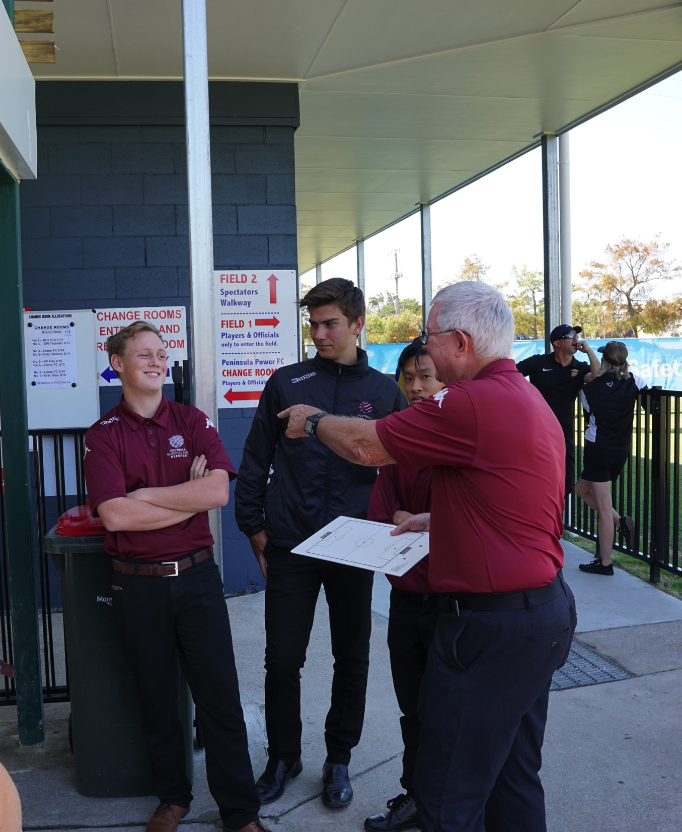
State Assessors Panel
Off season training / Level 1
State Tournaments
Talent Identified Assessors
Zone Level 2 / 3 Assessor
Notes:
Off season training is a work in progress. Ideas a weekend workshop involving a live HAL/WWL match. Sourcing Darryl Durham

Slide 18
Reaccreditation
Qualification | Activity (per year) | Coaching Sessions | Pass LOTG exam | Other requirements
Level 3 | 4 matches | 4 times | Yes – 70% | Review of 1 match report per year
Level 2 | 6 matches | 4 times | Yes – 80%
Level 1 | 8 matches | 4 times | Yes – 85%
Actively assessing in competition matches (or other matches approved by FFA).
Accreditation is valid for four years.
Notes:
As per page 150 of the FFA LOTG.
LOTG exam will be online and updated yearly.
Looking to videoing coaching so those that can attend can still reach the four sessions.
Accreditation is valid for four years.

Slide 19
QUESTIONS?

Slide 20
HAPPY LEARNING ☺
#thirdteam
Notes:
It’s time we forge our own path to making football great in qld.

Slide 21
TIPS AND TRICKS FOR REFEREE COACHES
Notes:
It’s time we forge our own path to making football great in qld.

